Slide 1
Online retailer customer segmentation THROUGH rfm analysis and kmeans clustering + strategic recommendations
Bryan mahony, senior data analyst

Slide 2
OUTLINE
Problem Statement
Executive Summary
Data Source
Analysis Overview
Strategic Recommendations

Slide 3
Problem statement
A UK-based online retailer known for unique, all-occasion giftware is looking to increase its customer retention and develop more targeted product strategies.
They shared 18 months of sales data from which they were looking to identify:
Unique customer profiles and potential revenue generating strategies for each
Patterns in sales for specific products
Any other insights which could boost sales and revenue generation

Slide 4
Executive summary
Using an RFM analysis, we can segment the customer base into three distinct customer profiles within the specified time segment. Based on the analysis we can suggest targeted marketing strategies to boost revenue from each segment.
There are 88 products which represent a subset of the highest-grossing products on OnlineCo’s website and are represented in the top 50 most purchased products across each customer segment, suggesting that broad-based marketing campaigns for these products could boost revenue across all customer segments.
We also took a look at frequently copurchased products – i.e. products that correlate with each other – for the 88 mentioned above to identify upselling and cross-product marketing opportunities.

Slide 5
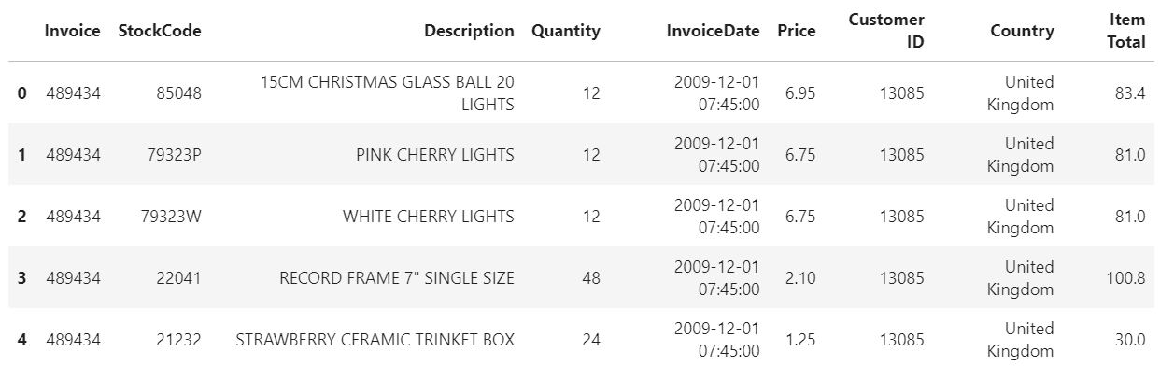
Data source
The sales data shared by OnlineCo covers a time period of 18 months between 1/12/20 and 9/12/20. Each of the 525,460 rows in the database represents a product purchased online, grouped by an invoice number and a customer ID (where applicable). Each row contains 9 features describing the product and its sale.

Slide 6
Analysis overview – RFM APPROACH
Based on the relatively short time period covered by the data, we chose an RFM analysis (recency, frequency, monetary value) to assess customer segmentation. This seeks to understand the distribution of the customer base along three dimensions:
Recency of purchase – how long has it been since the customer’s most recent transaction?
Frequency of purchases – how many times has a customer purchased from us during the time period?
Monetary value of purchases – how much has the customer spent with us over the time period?

Slide 7
Analysis overview - EDA
Through our exploratory data analysis, we found the following:
The dataset covers 28,816 unique transactions, of which 4,592 were returns (we will separate these and treat them differently later in the analysis)
We have 4,383 identified customer IDs, but 20% of the data does not have a customer ID associated with them and do have an invoice code. We will group that 20% by invoice code and treat them as unique, guest customers.
Of the 4,383 customers, the top 25 customers performed 2,081 transactions (7% of total volume). Of the total sales volume of $9.46M over the time period, these top customers represent $1.02M – or 10.8% - of the total revenue.

Slide 8
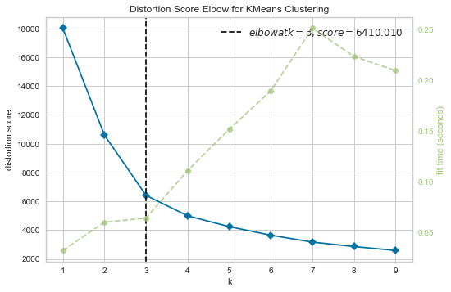
Analysis overview – rfm analysis / Kmeans clustering
After grouping our customers by recency, frequency, and monetary value*, we used a cross-validated KMeans clustering approach to identify clustering patterns in customer profiles – i.e. identifying customer segments.
Using yellowbrick’s KMeansVisualizer, we can see that a K of 3 produces the optimal distortion score – that is, there are three optimal segments in our customer data.
* Information on the RFM approach is included in the appendix

Slide 9
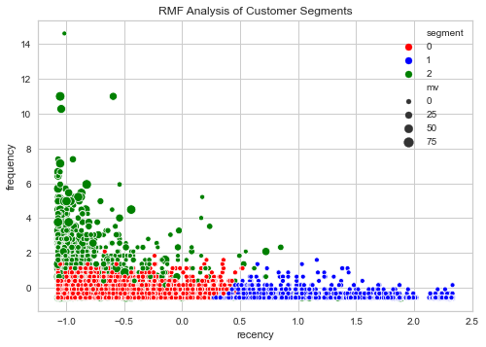
Analysis overview – rfm analysis / Kmeans clustering
Using a k of 3, our KMeans model can assign each of our customers to one of the 3 segments.
In the visual on the right, you see the segments represented by color, with (scaled) frequency and recency on the axes and size of the datapoint indicating monetary value.

Slide 10
Analysis overview – rfm analysis / Kmeans clustering
We can intuit our three customer profiles as follows based on the graph and the cluster centers provided by our KMeans model:
* Low frequency, low recency, low MV customers - customers who have purchased recently, have a small number of overall purchases, and make relatively lower total purchases (indicated in red)
* Low frequency, high recency, low MV customers - customers who have not purchased recently with a small number of overall purchases, and a low total purchase volume (indicated in blue)
* High frequency, high recency, high MV customers - customers who purchase relatively often and recently, and have a high purchase volume (indicated in green)
Our strategic recommendations will consider these profiles in light of their overall value and their purchasing habits.

Slide 11
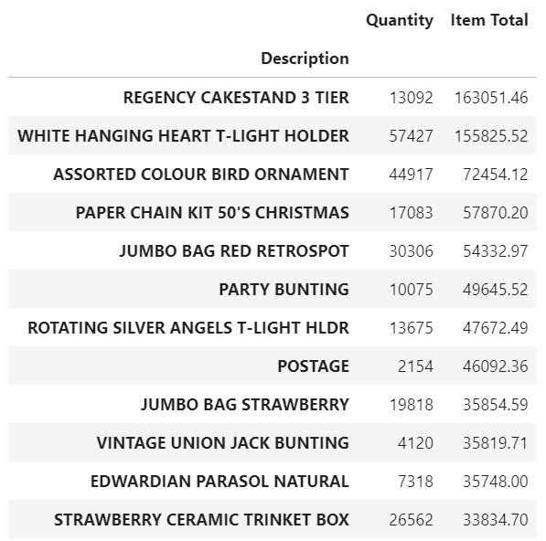
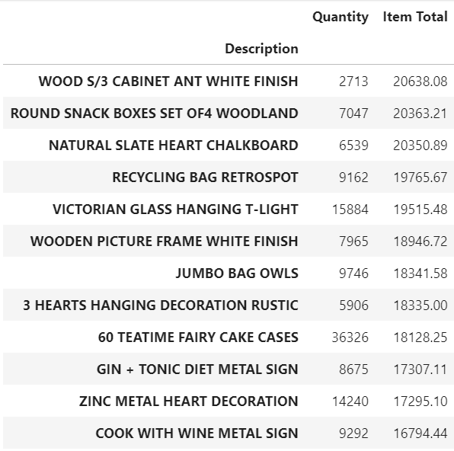
Analysis overview – Product sales
Top-grossing products
Top-grossing copurchases
Through transaction-level analysis, we have identified the top-grossing products as well as the products most often purchased in the same transactions as the most popular products.

Slide 12
Strategic recommendations – customer segmentation
 | Segment 0 | Segment 1 | Segment 2
Description | Low frequency, low recency, low MV | Low frequency, high recency, low MV customers | High frequency, high recency, high MV customers
Total sales over time period | $5.87M | $2.72M | $.86M
Total customer # | 3,615 | 755 | 1957
Avg transactions/customer | 3.95 | 11.38 | 1.34
Median transaction value | $229.57 | $247.60 | $139.34
Strategy type | Upselling | Reacquisition | Retention

Slide 13
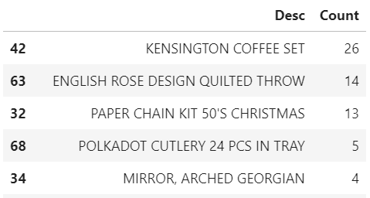
Strategic recommendations – PRODUCT ANALYSIS
The 88 top-grossing products across customer segments represent $2.46M of the $9.46M total sales. Targeted campaigns promoting sales of these 88 products (representing the common products across the top 50 purchased products by segment) could boost customer retention across all segments and generate significant additional revenue through increased purchasing.
These 88 products also represent items usually copurchased- that is, things like cupcake wrappers and decoration that are usually bought among other items. Through our analysis we have also offered an itemwise list of highly copurchased items – the below representing the top 5 products that are not themselves top sellers but are frequently copurchased with top sellers.

Slide 14
Strategic recommendations – PULLING IT ALL TOGETHER
Through this analysis, we have:
Identified customer segments distinguished by the recency, frequency, and monetary value of their purchases
Suggested campaign strategies to boost retention amongst customer profiles
Identified top-selling products and frequently co-purchased products to boost revenue generation through 1) increased sales across these categories and 2) boost customer acquisition through cross-product marketing
Provided a framework for assessing future customer campaigns, ensuring that we are minimizing churn through targeted strategies
In the appendix you will find examples of our coding and work + links to steps in the process.

Slide 15
APPENDIX – data wrangling
In our data wrangling, we had two main issues to solve for: guest transactions and creating standardized dimensions for the RFM analysis.
As a reminder, ~20% of the database rows were missing a customer ID but included an invoice code. We intuited that these represented guest transactions – e.g. transactions completed without creating an account.
To handle guest transactions, we generated a synthetic customer ID (outside of the range of 12346-18287 of “organic” customer IDs) for each invoice missing a value in the “Customer ID” field. In the RFM analysis, we treated these as customers with a single purchase.

Slide 16
APPENDIX – data wrangling
An RFM analysis seeks to assess customers across 3 dimensions: the recency of their most recent transaction, the frequency of their purchases over the specified time period, and the total monetary value (MV) of the purchases.
We used sklearn’s StandardScaler to create a comparable baseline across these dimensions – i.e. scaling each feature to mean zero, with values representing the number of standard deviations away from the mean. This was critical as Kmeans models are sensitive to unit magnitude (i.e., the number of days between 1/12/09 and 9/12/20 has a different order of magnitude than the total MV of purchases, which would throw off our machine learning model).
For the purposes of this exercise,
A “recency” score is the standardized number of days since the most recent purchase – a higher recency score indicating a customer who is more “lapsed” than one with a lower score.
A “frequency” score is the standardized number of purchases between 1/12/09 and 9/12/09
A “monetary value” score is the standardized sum of item gross for all purchases in the time period.

